Slide 1
Intro to Python for DS Saudi Digital Academy 2K20 Riyadh, Saudi Arabia Online
August 31, 2020

Slide 2
Schedule
8/30: Introduction to Data
Lesson Objective 1: Understand the history of data
Lesson Objective 2: Understand the history of data science
Lesson Objective 3: Understand what data science, data analysis, software development and data engineering are and how they relate
Assignment: Reading
8/31: Introduction to Data Analysis With Spreadsheets
Lesson Objective 1: Understand the spreadsheet concept
Lesson Objective 2: Import and Manipulate data in MS Excel
Lesson Objective 3: Build basic visualizations in MS Excel
Assignment: Intro to Stock Market Data

Slide 3
Notes on Learning how to Learn
The “Cycle of Learning”
Know why you are learning something.
Work in short highly active and focused periods.
Take a break
Review what just learned before starting something new.
Make connections
Write our experiences to our long-term memory
Your Brain
Concept
Concept
Concept
Notes:
Here’s how we will be working through the workshop today.
1. We will go through each section by starting with why we are learning a specific topic and section, I start by giving a high level overview of the materials we are covering and how this content fits into the big picture.
2. When we work, we work short periods of time with high concentration and intensity. With few distractions.
3. After we’ve finished a section we will take a break.
4. Before we start on new material we will review the material that we just covered.
a. While we are reviewing we need to make connections. We should connect and think about the new concepts we are learning and connect them to old concepts.
b. By making connections and associating data with other data that we are familiar with, we retain the things we learn better.
c. Our brains are giant classification modeling engines.

Slide 4
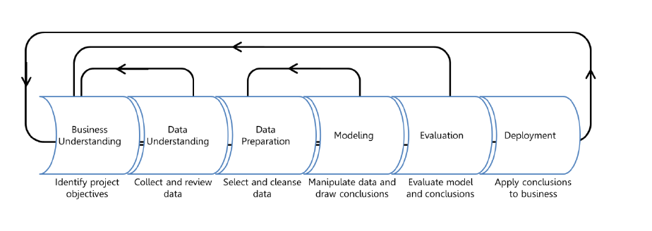
Data Science Process
Extracting value from large amounts of data and making human sense of it is the primary challenge of data science.
Domain Expertise
Data
Science
Code/Computing Expertise
Math/Statistics

Slide 5
Activity Agenda
 | Introduction to Data Science
 | Python basics
 | NumPy: Your Local Data Friend
 | Pandas are more than bears: How to import, clean, and store data
 | Data Science 101: Getting your Data Ready
 | Wrap Up and Next Steps

Slide 6
Let’s begin by cloning our workshop Notebook
VSC:
https://code.visualstudio.com/
Notebook:
https://github.com/daniel-dc-cd/data_science/tree/master/projects/data_science_intro
You will need:
https://www.python.org/downloads/
https://jupyter.org/install.html
You are also going to need some dependencies. When you run jupyter, and you get an error, note it and troubleshoot it.

Slide 7
Python basics
Section 1

Slide 8
Section 1 overview
What you will know by the end of section 1
Arithmetic and numeric types in Python
Strings, strings, and more strings
Other data types
Lists
Tuples
Dictionaries
Membership testing
List comprehensions
Importing modules

Slide 9

Section 1 overview
Why Python for data science?
Easy to learn
Flexible
Powerful libraries
Leading social network, video streaming, and search engine companies built some of their core technologies using Python. They also use Python for data science.
Notes:
Generic examples
Leading social network, video streaming, and search engine companies built some of their core technologies using Python and use Python for data science.
Specific examples
Google, YouTube, Facebook, and Pinterest were all built to different extents using Python (www.quora.com/What-programming-languages-are-used-at-Youtube,
https://en.wikipedia.org/wiki/Programming_languages_used_in_most_popular_websites). These companies also use Python for data science for many of the same reasons that you will study Python: it is easy to develop in, flexible, and contains powerful libraries for data science.
"Python is fast enough for our site and allows us to produce features that can be maintained in record time, with a minimum of developers."
— Cuong Do, Software Architect at YouTube (https://www.quora.com/What-programming-languages-are-used-at-Youtube)

Slide 10
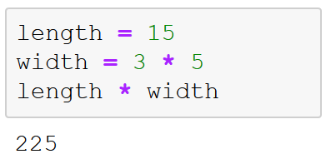
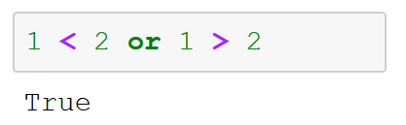
Operators, Variables and Expressions
Python numeric operators: + - * / // ** %
Variables:
Expressions:
Notes:
Variables:
You don’t need to declare variables or their type before using them.
Variable types can be changed as needed.
Built-in variable “_”: the value of the last printed expression
Expressions
Return true or false values
As with other programming languages, expressions are critical for decision-making, controlling the logical flow of Python programs. The most fundamental way of doing this in Python is with a comparison operator, such as <
Can be combined with AND, OR, and NOT

Slide 11
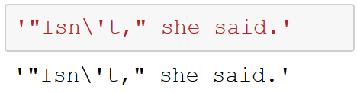
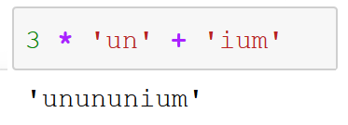
Strings
String literals:
Concatenating strings:
Notes:
String literals are enclosed in single quotes ('...') or double quotes ("...") with the same result. Use \ to escape quotes; that is, use \ in order to use quotation marks within the string itself.
Strings can be concatenated (glued together) with the + operator and repeated with *. Two or more string literals placed next to each other are automatically concatenated.

Slide 12
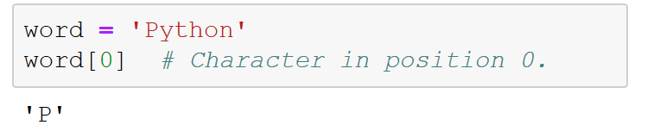
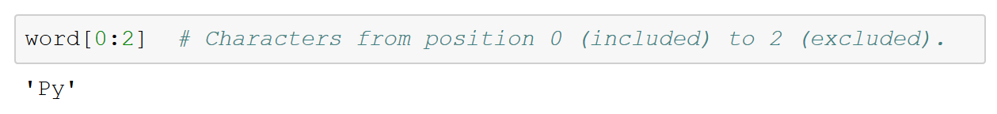
Strings (continued)
String indices:
Slicing strings:
Notes:
String indices: Strings can be indexed (subscripted), with the first character having index 0.
Indices can also be negative numbers, which means to start counting from the end of the string. Negative indices start from ‒1.
Python also supports slicing, which extracts a substring. To slice, you indicate a range in the format start:end, where the start position is included but the end position is excluded.

Slide 13
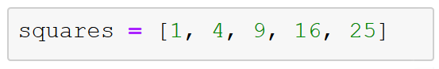
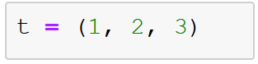
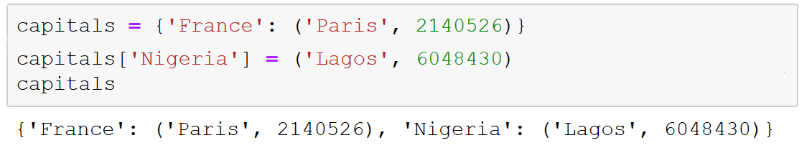
Other data types
Lists:
List-object methods: append(), extend(), index(), count(), remove(), pop(), insert(), reverse(), sort().
Tuples:
Dictionaries:
Notes:
The string and numeric data types we have looked at so far are common to many programming languages. The other data types that we will look at—lists, tuples, and dictionaries—set Python apart from C++ or Java by providing powerful and easy-to-use built-in data structures.
A list can be written as a sequence of comma-separated values (items) between square brackets. Lists might contain items of different types, but usually the items all have the same type. Like strings (and all other built-in sequence types), lists can be indexed and sliced.
List object methods: Python include a number of handy methods that are available to all list objects. For example, append() and extend() enable you to add to the end of a list much like the += operator. The index() method returns the index of the first matching item in a list (if present). The count() method returns the number of items in a list that match objects you pass in.
There are two methods for removing items from a list. The first is remove(), which locates the first occurrence of an item in list and removes it (if present). The other method for removing items from lists is the pop() method. If you supply pop() with an index number, it will remove the item from that location in the list and return it; otherwise, pop() removes the last item in a list and returns it. The insert() method enables you to add an item to a specific location in a list. Unsurprisingly, the reverse() method reverses the order of items in a list. Finally, the sort() method orders the items in a list.
Tuples are immutable lists. To create tuples, you use parentheses instead of brackets. Tuples can be useful to create a data structure that won't be altered later in a program. Once they’re defined, you cannot change elements within them.
Dictionaries in Python provide a means of mapping information between unique keys and values. You create dictionaries by listing zero or more key-value pairs inside of curly braces.

Slide 14
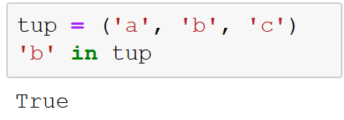
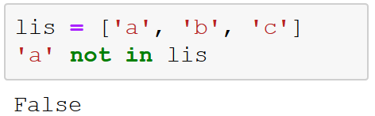
Membership testing
‘in’:
‘not in’:
Notes:
As your Python programming grows more complex, you will want to test lists and tuples for the membership of specific data. The “in” operator enables you to do that. You can also test to see if something is not in a list or tuple using “not in.”

Slide 15
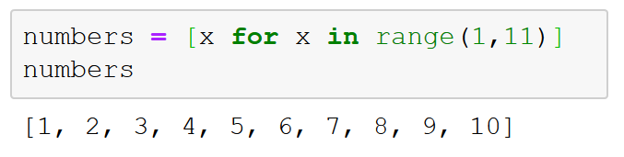
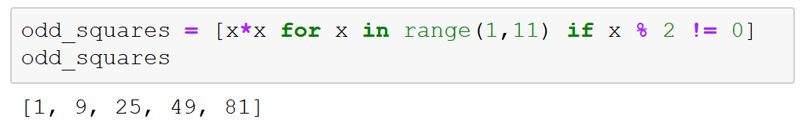
List comprehensions
Programmatically create lists:
Notes:
List comprehensions are algorithmically generated lists.

Slide 16
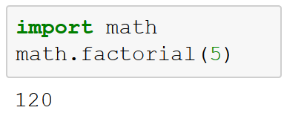
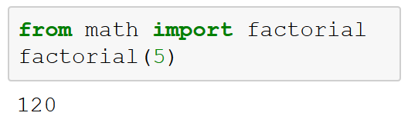
Importing modules
Notes:
If you quit from the Python interpreter and enter it again, the definitions you have made (your functions and variables) will be lost. Similarly, you might also want to use a handy function that you’ve written in several programs without copying its definition into each program.
To support this capability, Python has a way to put definitions in a file and use them in a script or in an interactive instance of the interpreter. Such a file is called a module. Definitions from a module can be imported into other programs or modules.
For example, the factorial() function is not one of the standard functions built into Python. It is part of the Python math module.

Slide 17
Intro to NumPy
Section 2

Slide 18
Section 2 overview
What you will know by the end of section 2
Built-in help
NumPy arrays
Creating
Attributes
Indexing
Reshaping
Splitting and joining
Fancy indexing
Sorting
Aggregations

Slide 19

Section 2 overview
Why NumPy?
Faster, pre-compiled functions
Standard numeric library for data science using Python
Foundation for other popular libraries (such as pandas)
The City of Los Angeles uses NumPy to predict illegal eviction of apartment tenants
Notes:
The City of Los Angeles uses NumPy (in conjunction with pandas) to predict illegal eviction of tenants from rent-controlled apartment buildings under the California Ellis Act (https://www.youtube.com/watch?v=JBFCsrPPEtc&t=5m43s). NumPy provides pre-compiled functions that are faster than regular Python functions (particularly on large datasets), and it is a standard numeric library for data science conducted using Python. It is also the foundation for another popular and important library we will examine later in the course: pandas.

Slide 20
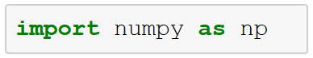
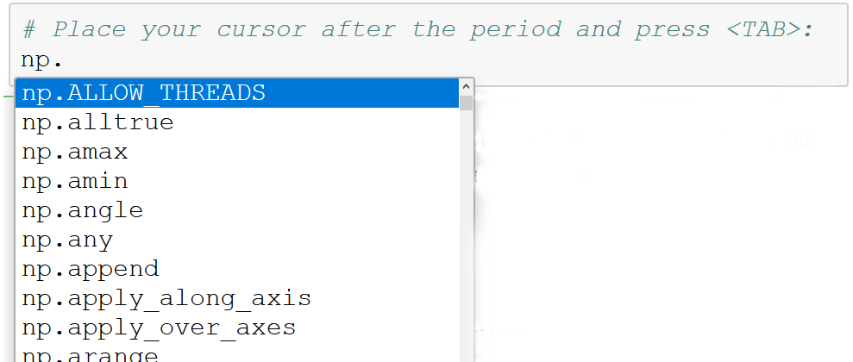
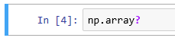
IPython and built-in help
Use the tab key to explore package contents.
Use “?” for help info related to any method.
Notes:
IPython is an interactive command-line terminal for Python and one of the main features of Jupyter notebooks. Code cells in Jupyter notebooks use IPython.
IPython gives you the ability to quickly explore the contents of a package like NumPy by using the tab-completion feature. So, if you want to see all of the functions available with NumPy, type this:
In [1]: np.<TAB>
Append “?” to any method to bring up the help info for that method.

Slide 21
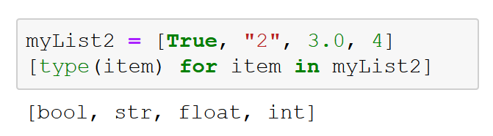
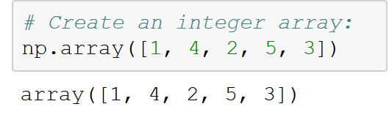
NumPy arrays
Lists in Python:
NumPy data types: floating point, integer, Boolean, string, general Python object
Fixed-type arrays in Python:
Notes:
In Python, the types are dynamically inferred. The standard mutable multi-element container in Python is the list.
Lists are flexible, but they can become expensive in terms of memory and performance if we are dealing with hundreds of thousands or millions of items in a list. In contrast, NumPy arrays (also known as ndarrays) are efficient memory-wise and computationally.
Fixed type arrays can be created:
np.zeros
np.ones

Slide 22
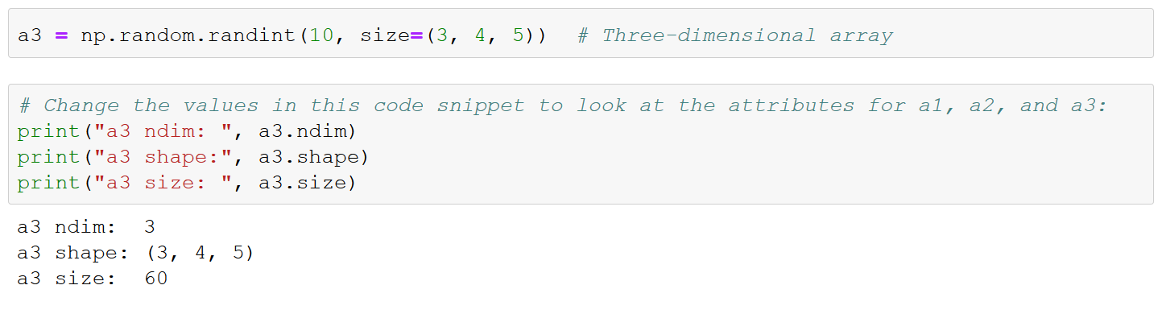
Working with NumPy arrays: array attributes
Notes:
Array attributes
On this slide, we start by defining three arrays filled with random numbers: one one-dimensional, another two-dimensional, and the last three-dimensional. We then print out various attributes of the array.
Each array has attributes ndim (the number of dimensions), shape (the size of each dimension), and size (the total size of the array). Another useful attribute is the dtype, the data type of the array. Other attributes include itemsize, which lists the size (in bytes) of each array element, and nbytes, which lists the total size (in bytes) of the array.

Slide 23
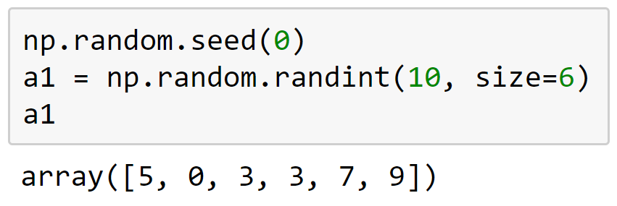
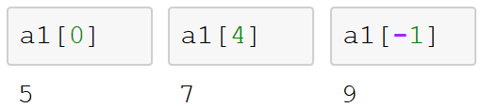
Working with NumPy arrays: indexing
Notes:
Indexing arrays: Getting and setting the value of individual array elements.
In a one-dimensional array, the 𝑖 th value (counting from zero) can be accessed by specifying the desired index in square brackets, just as with Python lists.

Slide 24
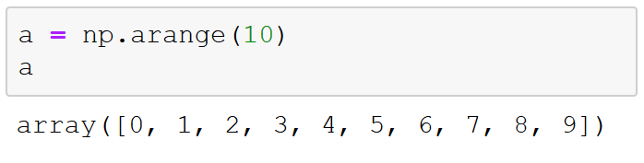
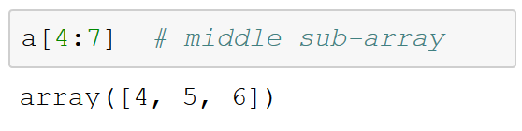
Working with NumPy arrays: slicing arrays
Notes:
Slicing arrays: Getting and setting smaller subarrays within a larger array

Slide 25
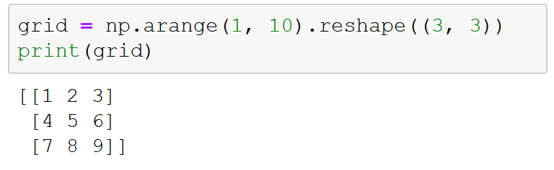
Working with NumPy arrays: reshaping
Notes:
Reshaping arrays: Changing the shape of a given array
Note that, for this to work via the reshape method, the size of the initial array must match the size of the reshaped array.
Another common reshaping pattern is the conversion of a one-dimensional array into a two-dimensional row or column matrix. This can be done with the reshape method, or more easily done by making use of the newaxis keyword within a slice operation.

Slide 26
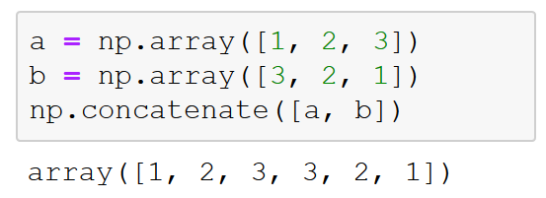
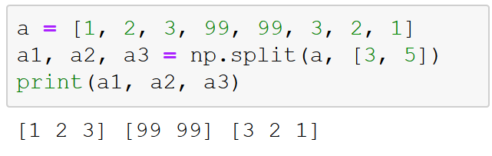
Working with NumPy arrays: joining and splitting
Notes:
Joining and splitting arrays: Combining multiple arrays into one and splitting one array into multiple arrays.
Concatenation, or joining of two arrays in NumPy, is primarily accomplished using the routines np.concatenate, np.vstack, and np.hstack. np.concatenate takes a tuple or list of arrays as its first argument.
The opposite of concatenation is splitting, which is implemented by the functions np.split, np.hsplit, and np.vsplit. For each of these, we can pass a list of indices giving the split points.

Slide 27
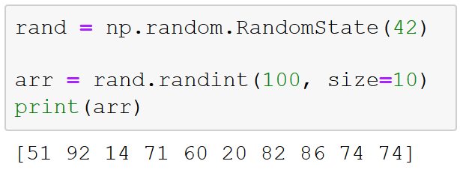
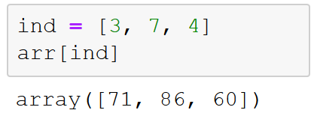
Working with NumPy arrays: fancy indexing
Notes:
In fancy indexing, we pass an array of indices to an array in order to access or modify multiple array elements at the same time.

Slide 28
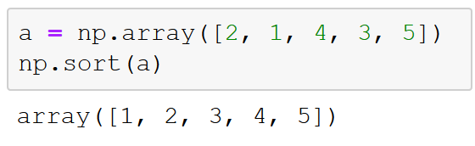
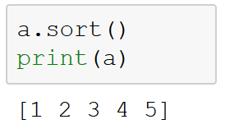
Working with NumPy arrays: sorting
Notes:
So far, we have just worried about accessing and modifying NumPy arrays. Another huge thing you will need to do as a data scientist is sort array data. Although you could use Python's built-in sort and sorted functions, they will not work nearly as efficiently as NumPy's np.sort function. The np.sort function returns a sorted version of an array without modifying the input.
Or, to sort the array in-place, use the sort method directly on arrays.

Slide 29
NumPy universal functions (ufuncs)
Operate on NumPy arrays
Compiled in C
Much faster than traditional Python-based operations
Noticeable performance gain working with large datasets
Notes:
Ufuncs
Universal functions in NumPy (often shortened to ufuncs) provide a statically typed, compiled function for many of the operations that we will need to run in the course of manipulating and analyzing data.
Ufuncs can be used between a scalar and an array and between arrays of arbitrary dimensions.
Computations vectorized by ufuncs are almost always more efficient than doing the same computation by using Python loops. This is especially true on large arrays. When possible, try to use ufuncs when operating on NumPy arrays, rather than using ordinary Python loops.
Ufuncs come in two flavors: unary ufuncs, which use a single input, and binary ufuncs, which operate on two inputs.

Slide 30
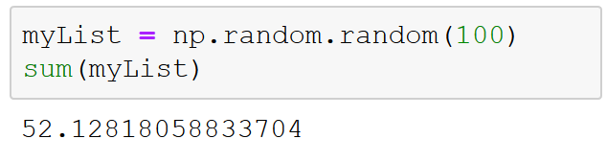
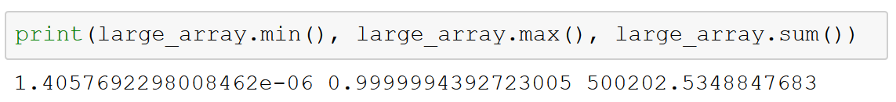
Aggregations
Summing the values in arrays:
Minimum and maximum values:
Notes:
Aggregations
One of the first things you will find yourself doing with most datasets is computing the summary statistics for the data. These include the mean and standard deviation, in addition to other aggregates, such as the sum, product, median, minimum, and maximum, or quantiles of the data.
NumPy has fast built-in aggregation functions for working on arrays.
Summing the values of an array
You can use the built-in Python sum function to sum up the values in an array.
Minimum and maximum
Just as Python has built-in min and max functions, NumPy has similar, vectorized versions. You can also use min, max, and sum (and several other NumPy aggregates) as methods of the array object itself.

Slide 31
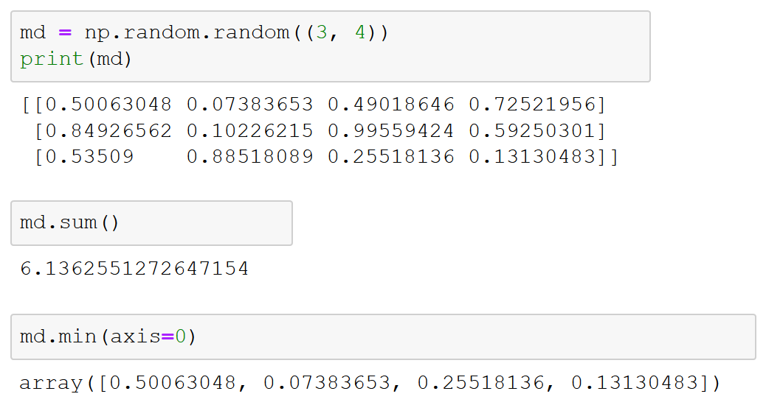
Multidimensional aggregations
Notes:
Multidimensional aggregates
You will often need to aggregate array data along a row or column. Unless you specify otherwise, each NumPy aggregation function will compute the aggregate for the entire array.
Aggregation functions take an additional argument specifying the axis along which to compute the aggregation. For example, we can find the minimum value within each column by specifying axis=0.

Slide 32
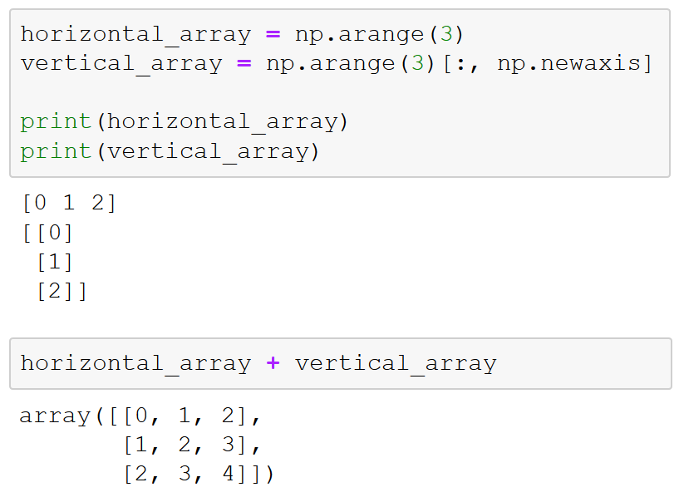
Broadcasting
Apply ufuncs to arrays of different sizes:
“Pad” dimensions in arrays to match
Stretch one-dimensional arrays
Notes:
Computation on arrays with broadcasting
Another means of vectorizing operations is to use NumPy's broadcasting functionality: creating rules for applying binary ufuncs like addition, subtraction, or multiplication on arrays of different sizes.

Slide 33
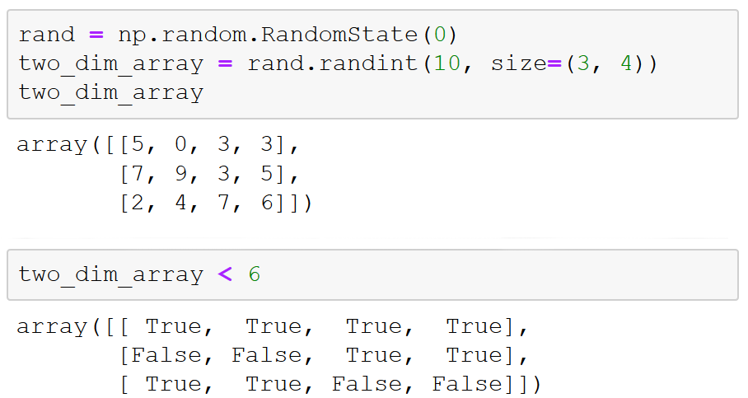
Comparison operators as ufuncs
Notes:
Comparison operators as ufuncs
In addition to the computational operators as ufuncs that we have already encountered, NumPy also implements comparison operators such as < (less than) and > (greater than) as element-wise ufuncs. All of the standard Python comparison operations are available.

Slide 34
Intro to pandas
Section 3

Slide 35
Section 3 overview
What you will know by the end of section 3
Data structures in pandas
Series
DataFrames
Manipulating data
In Series
In DataFrames
Data operations
Index preservation
Index alignment
Operations between Series and DataFrames

Slide 36

Section 3 overview
Why pandas?
Standard Python library for handling and manipulating general data
Intuitive tabular data structure (DataFrame)
Fast data calculation and transformation using NumPy
Close integration with visualization libraries to easily explore data
The leading online video-streaming service uses pandas and Jupyter notebooks for data exploration, preparation, and validation
Notes:
Generic example
The leading online video-streaming service uses pandas and Jupyter notebooks for data exploration, preparation, and validation.
Specific example
Netflix uses pandas (and Jupyter notebooks) for data exploration, preparation, and validation: “data munging,” the subject of section 5 (https://medium.com/netflix-techblog/notebook-innovation-591ee3221233). Netflix also uses pandas as part of the wider Python scientific stack (NumPy, Scipy, scikit-learn, MatPlotLib, and pandas) for machine learning and automated analysis (https://medium.com/netflix-techblog/python-at-netflix-bba45dae649e).

Slide 37
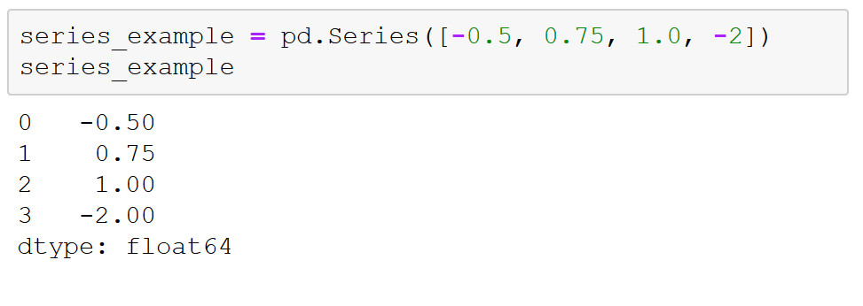
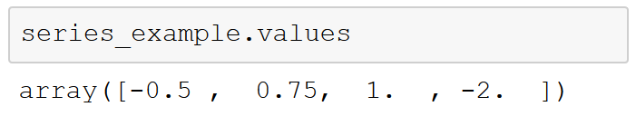
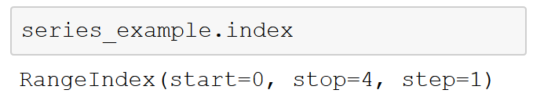
Fundamental pandas data structures: Series
Notes:
Both Series and DataFrames are a lot like the ndarrays you encountered in the last section. They provide clean, efficient data storage and handling at the scales necessary for data science. What both of them provide that ndarrays lack, however, are essential data-science features like flexibility when dealing with missing data and the ability to label data. These capabilities (along with others) help make Series and DataFrames essential to the “data munging” that makes up so much of data science.
Series objects in pandas
A pandas Series is a lot like an ndarray in NumPy: a one-dimensional array of indexed data. You can create a simple Series from an array of data.
Similar to an ndarray, a Series upcasts entries to be of the same type of data (that –2 integer in the original array became a – 2.00 float in the Series).
What is different from an ndarray is that a Series automatically wraps both a sequence of values and a sequence of indices. There are two separate objects within the Series object that you can access with the values and index attributes.

Slide 38
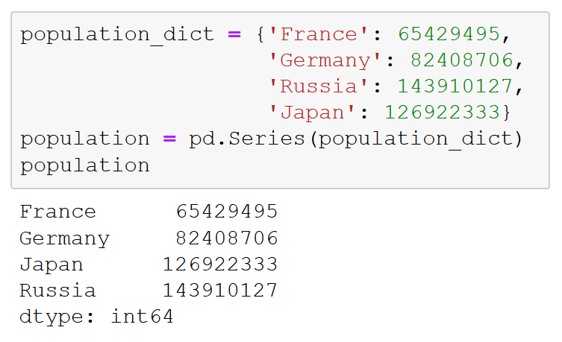
Pandas data structures: DataFrames
Creating a DataFrame from a dictionary:
Notes:
The DataFrame object in pandas
The other crucial data structure in pandas to get to know for data science is the DataFrame. Like the Series object, a DataFrame can be thought of as either a generalization of ndarrays or as specializations of Python dictionaries.
Just as a Series is like a one-dimensional array with flexible indices, a DataFrame is like a two-dimensional array with both flexible row indices and flexible column names. Essentially, a DataFrame represents a rectangular table of data, and it contains an ordered collection of labeled columns, each of which can be a different value type (such as string, int, and float). The DataFrame has both a row and column index; in this way, you can think of it as a dictionary of Series, all of which share the same index.

Slide 39
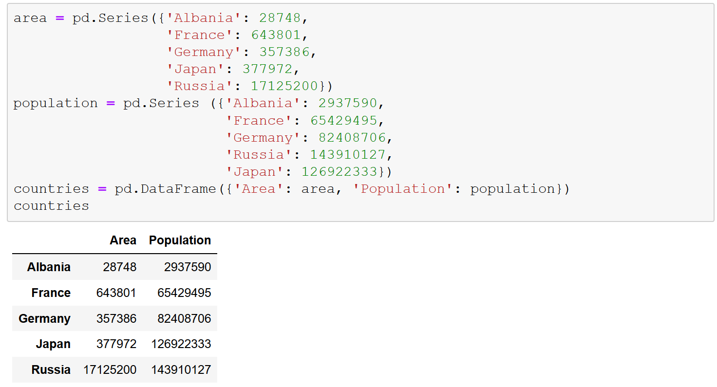
Pandas data structures: DataFrames
Creating a DataFrame from two series:
Notes:
In this example, we create a DataFrame from two series, “area” and “population.”

Slide 40
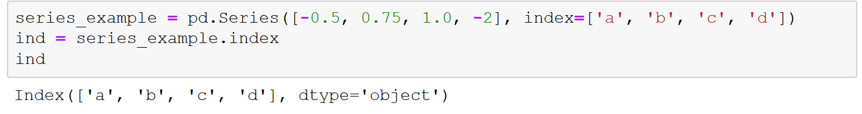
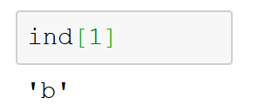
Manipulating data in pandas: index objects
Notes:
Index objects in pandas
Both Series and DataFrames in pandas have explicit indices that enable you to reference and modify data in them. These indices are actually objects themselves. The Index object can be thought of as both an immutable array and a fixed-size set.
It's worth taking the time to get to know the properties of the Index object. Let's return to an example from earlier in this section to examine these properties.
The Index works a lot like an array. But Index objects are immutable; they cannot be modified via the normal means.
This immutability is a good thing: it makes it safer to share indices between multiple Series or DataFrames without the potential for problems arising from inadvertent index modification.
In addition to being array-like, an Index also behaves like a fixed-size set, including following many of the conventions used by Python's built-in set data structure, so that unions, intersections, differences, and other combinations can be computed in a familiar way. Let's play around with this to see it in action.

Slide 41
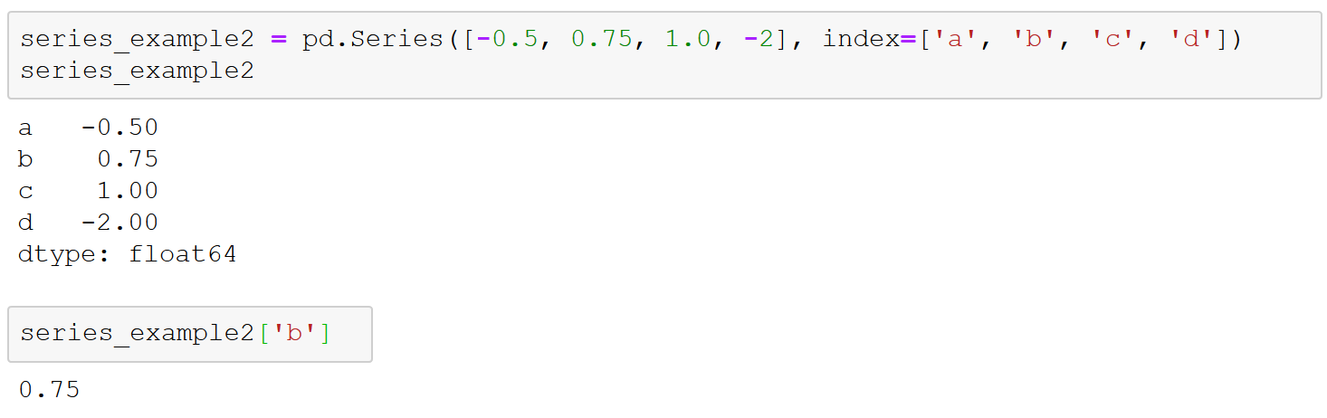
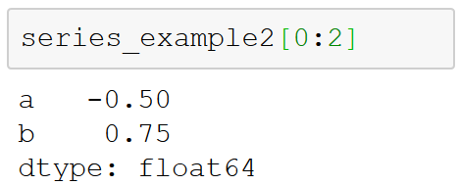
Manipulating data: data selection in Series
Notes:
Data selection in Series
As a refresher, a Series object acts in many ways like both a one-dimensional ndarray and a standard Python dictionary.
Like a dictionary, the Series object provides a mapping from a collection of arbitrary keys to a collection of arbitrary values.
Because Series also provide array-style functionality, you can use the NumPy techniques we looked at in Section 3 like slices, masking, and fancy indexing.

Slide 42
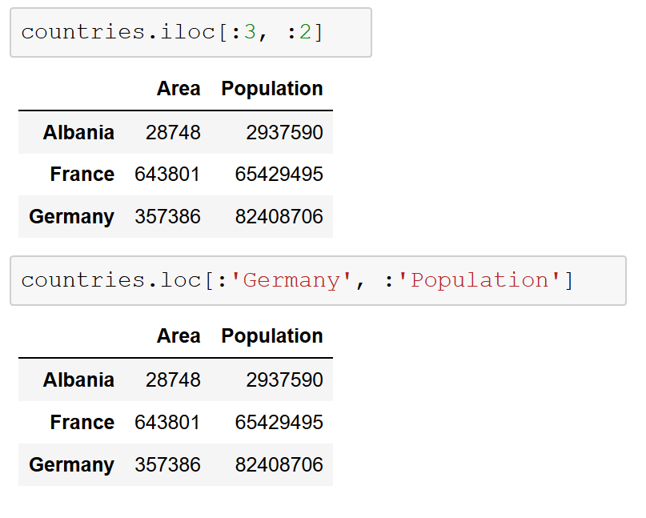
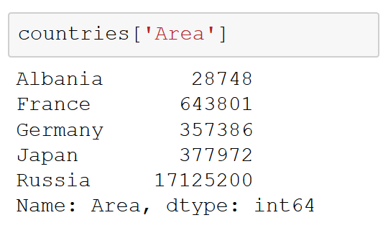
Manipulating data: data selection in DataFrames
Notes:
See slide 41 for a complete DataFrame. Slide title: “Pandas data structures: DataFrames.”
DataFrames uses the loc and iloc indexers. With iloc, you can index the underlying array as if it were an ndarray, but with the DataFrame index and column labels maintained in the result.
loc also permits array-like slicing but using the explicit index and column names.

Slide 43
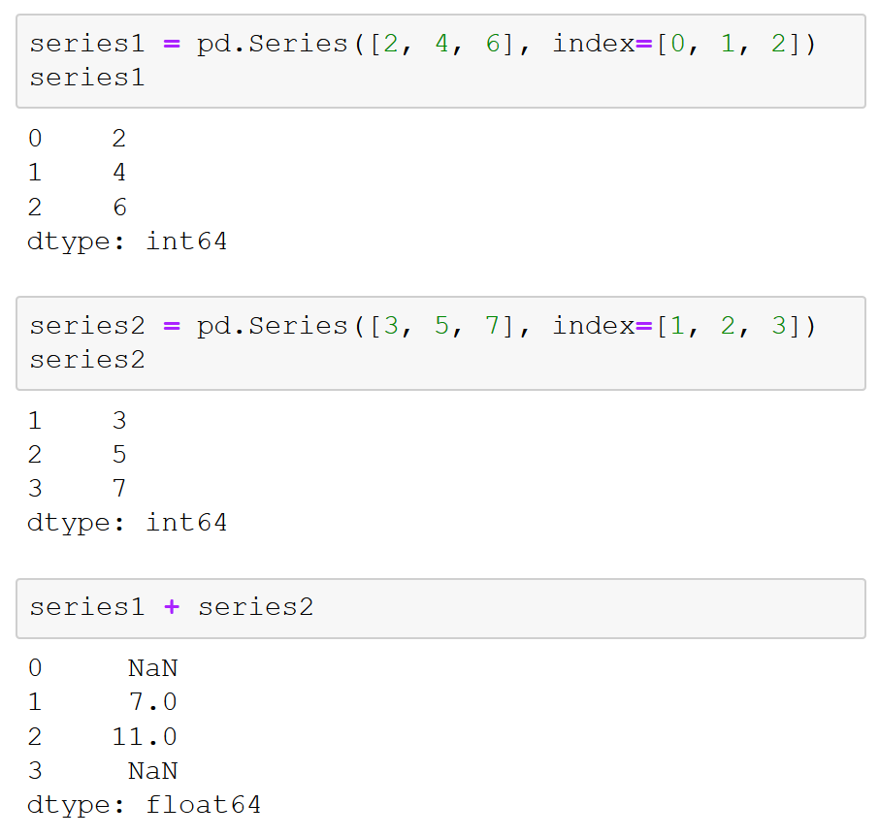

Operating on data in pandas: index alignment
Notes:
Index alignment
When you perform a binary operation on two Series or DataFrame objects, pandas will align indices in the process of performing the operation. This is essential when working with incomplete data (and data is usually incomplete).
NaN values are not always convenient to work with; NaN, combined with any other values, results in NaN, which can be a pain, particularly if you are combining multiple data sources with missing values. To help with this, pandas allows you to specify a default value to use for missing values in the operation.
Index alignment with DataFrames
The same kind of alignment takes place in both dimensions (columns and indices) when you perform operations on DataFrames.

Slide 44
Manipulating and cleaning data
Section 4

Slide 45
Section 4 overview
What you will know by the end of section 4
Exploring information in DataFrames
Working with missing data values
Identifying
Removing
Filling
Combining datasets
Exploratory statistics and visualizations
Example: Boston Housing dataset

Slide 46

About 80% of project time is usually spent cleaning and preparing data for the actual analysis
Notes:
A widely accepted rule of thumb in data science is that about 80 percent of every project will be spent cleaning and preparing data for the actual analysis. For this reason, it is vital to master these skills, no matter what one does in data science.
Why practice “data munging?”
Both science…and art
Essential to high-quality insights / outcomes

Slide 47



Exploring DataFrame information
DataFrame.info
DataFrame.head
DataFrame.tail
Notes:
DataFrame.info lists the columns and number of entries.
DataFrame.head returns the first five rows of a DataFrame (by default).
DataFrame.tail returns the last five rows of a DataFrame.

Slide 48





Dealing with missing data
Python null value: None
NumPy/pandas null value: NaN
Notes:
Dealing with missing data
Most of the time, the datasets you want to use (or have to use) have missing values in them. How missing data is handled carries with it subtle tradeoffs that can affect your final analysis and real-world outcomes.
Pandas handles missing values in two ways. The first you've seen before in previous sections: NaN, or Not a Number. This is actually a special value that is part of the IEEE floating-point specification, and it is only used to indicate missing floating-point values.
For missing values apart from floats, pandas uses the Python None object. While it might seem confusing that you will encounter two different kinds of values that say essentially the same thing, there are sound programmatic reasons for this design choice and, in practice, going this route enables pandas to deliver a good compromise for the vast majority of cases. Notwithstanding this, both None and NaN carry restrictions that you need to be mindful of with regards to how they can be used.
None: non-float missing data
Because None comes from Python, it cannot be used in NumPy and pandas arrays that are not of data type “object”. Remember, NumPy arrays (and the data structures in pandas) can contain only one type of data. This is what gives them their tremendous power for large-scale data and computational work, but it also limits their flexibility. Such arrays have to upcast to the “lowest common denominator,” the data type that will encompass everything in the array. When None is in the array, it means you are working with Python objects.
NaN: missing float values
In contrast to None, NumPy (and therefore pandas) supports NaN for its fast, vectorized operations and ufuncs. The bad news is that any arithmetic performed on NaN always results in NaN.
NaN and None: null values in pandas
Even though NaN and None can behave somewhat differently, pandas is nevertheless built to handle them interchangeably.
Detecting null values
Both isnull() and notnull() are your primary methods for detecting null data. Both return Boolean masks over your data.
Dropping null values
Beyond identifying missing values, pandas provides a convenient means to remove null values from Series and DataFrames. (Particularly on large datasets, it is often more advisable to simply remove missing [NA] values from your analysis than deal with them in other ways.)
You cannot drop a single value from a DataFrame, so you have to drop full rows or columns. Depending on what you are doing, you might want to do one or the other, and so pandas gives you options for both. Because, in data science, columns generally represent variables and rows represent observations, you are more likely to drop rows of data; the default setting for dropna() is to drop all rows that contain any null values.
Filling null values
Depending on your dataset, it can sometimes make more sense to fill null values with valid ones rather than drop them. You could use isnull to do this in place, but that can be laborious, particularly if you have a lot of values to fill. Because this is such a common task in data science, pandas provides fillna, which returns a copy of the Series or DataFrame with the missing values replaced with one of your choosing.

Slide 49



Removing duplicate data
Identifying duplicates
Dropping duplicates
Notes:
Removing duplicate data
In addition to missing data, you will often encounter duplicated data in real-world datasets. Fortunately, pandas provides an easy means of detecting and removing duplicate entries.
Identifying duplicates: duplicated
You can easily spot duplicate values using the duplicated method in pandas, which returns a Boolean mask indicating whether an entry in a DataFrame is a duplicate of an earlier one. Let's create another example DataFrame to see this in action.
Dropping duplicates: drop_duplicates.
drop_duplicates simply returns a copy of the data for which all of the duplicated values are False

Slide 50



Combining datasets
Categories of joins:
one-to-one, many-to-one, and many-to-many
Concatenation in NumPy:
Concatenation in pandas:
Concatenation with joins:
Notes:
Combining datasets: merge and join
Your most interesting analyses will often come from data melded together from more than one source. Because of this, panda provides several methods of merging and joining datasets to make this necessary job easier:
pandas.merge connects rows in DataFrames based on one or more keys.
pandas.concat concatenates or “stacks” together objects along an axis.
The combine_first instance method enables you to splice together overlapping data to fill in missing values in one object with values from another.
Categories of joins
Merge carries out several types of joins: one-to-one, many-to-one, and many-to-many. You use the same basic function call to implement all of them, and we will examine all three (because you will need all three at some point in your data delving, depending on the data). We will start with one-to-one joins because they are generally the simplest example.
Concatenation in NumPy
Concatenation in pandas is built off of the concatenation functionality for NumPy arrays.
Concatenation in pandas
Pandas has a function, pd.concat(), that can be used for a simple concatenation of Series or DataFrame objects in similar manner to np.concatenate() with ndarrays.
Concatenation with joins
Just as you did with merge above, you can use inner and outer joins when concatenating DataFrames with different sets of column names.

Slide 51




Exploratory statistics and visualization
Notes:
Exploratory statistics and visualization
Often, when probing a new dataset, it is invaluable to get high-level information about what the dataset holds. Earlier in this section, we discussed using methods such as DataFrame.info, DataFrame.head, and DataFrame.tail to examine some aspects of a DataFrame. While these methods are critical, they are on their own often insufficient to get enough information to know how to approach a new dataset. This is where exploratory statistics and visualizations for datasets come in.
One of the first methods we can use to better understand this dataset is DataFrame.shape.
To get a better idea of the contents of each column, we can use DataFrame.describe, which returns the maximum value, minimum value, mean, and standard deviation of numeric values in each columns, in addition to the quartiles for each column.
Note that you can also examine specific descriptive statistics for columns without having to invoke DataFrame.describe.

